Slide 1
Use the Other Hand
The quick brown fox jumps over the lazy dog.
Notes:
Uncomfortable – remember this feeling
How non-tech people feel when we engage in tech speak.

Slide 2
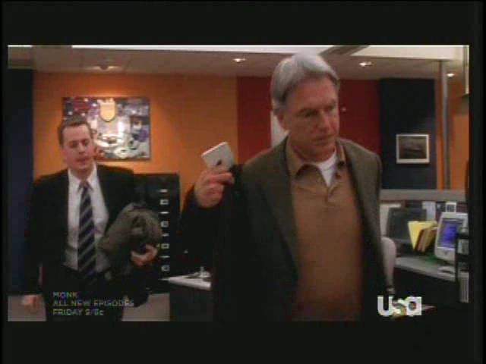
Notes:
Make sure everyone knows what OS/2 is

Slide 3
Communicating with the Non-technical
No – this does not qualify for foreign language credit.

Slide 4
Don’t Do What I Did
DOD funded CMU’s SEI, an FFRDC, to create CMM, now CMMI.
Notes:
Story of acronym-laden question (to sound superior) and I didn’t translate

Slide 5
D&C 121
41 No power or influence can or ought to be maintained by virtue of the priesthood, only by persuasion, by long-suffering, by gentleness and meekness, and by love unfeigned;
42 By kindness, and pure knowledge, which shall greatly enlarge the soul without hypocrisy, and without guile—

Slide 6
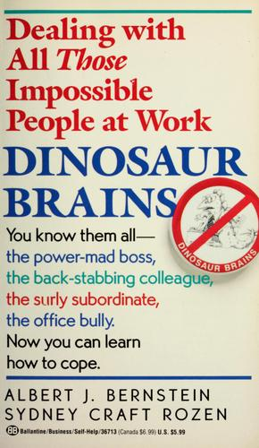
Dinosaur Brains
Albert J. Bernstein and Sydney Craft Rozen
Dinosaur Brains: Dealing with All Those Impossible People at Work
1989
Notes:
Will read from chapter 30, “The Customer from Outer Space”
Make sure everyone knows what Three’s Company is

Slide 7

The Customer from Outer Space
Notes:
http://www.fantom-xp.com/wallpapers/23/Windows_7_-_Alien_from_outer_space.jpg

Slide 8
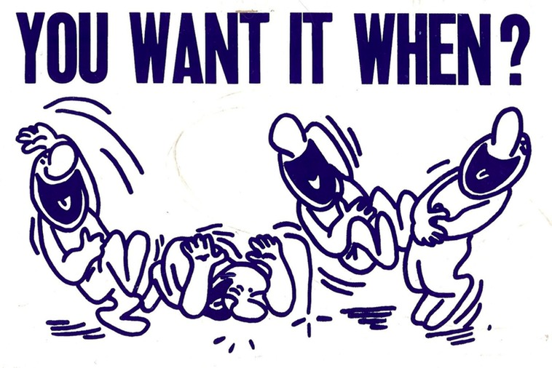
Notes:
http://www.billyalexander.us/_Media/you_want_it_when_med.jpeg

Slide 9

“The elevation of cholesterol and triglycerides indicates a marginal case of hyperlipidemia. The part I’m most concerned about is the unfavorable ratio of low-density to high-density lipoproteins. This probably indicates a preponderance of saturated fatty acids in the diet, which you’ll have to strictly control, because it definitely elevates your risk of coronary heart disease.”
Notes:
Doctor
http://twilightinsight.files.wordpress.com/2008/10/doctor-frowning.jpg

Slide 10

“Each portfolio pays the company a supplemental distribution fee equal, on an annual basis, to one percent of the aggregate purchase payment for shares sold since inception, including the purchase price of shares transferred from within and without the fund. This, of course, excludes appreciation, reinvested dividends and capital gain distributions.”
Notes:
Stockbroker
http://elegantinnerguidance.com/wp-content/uploads/2011/04/Serious-woman-in-business.jpg

Slide 11

“You should never execute a contract without the proviso that you retract copyrights given the conditions subsequent that the publishers fail to comply with their promises both stated and unstated at any future time. But you may not need that language because in most states a contract that did not imply that protection would probably be considered unconscionable anyway.”
Notes:
http://www.boston-bankruptcy-info.com/images/Attorney%20Matthew%20E.%20Jones.jpg

Slide 12

“You may think you feel stupid but you’re really angry. Your hostility toward authority figures is threatening to you because of unresolved conflicts with your father. You repress these hostile feelings and attempt to appear overly responsible and productive. This is clearly a reaction formation.
“You may sublimate your hostility by writing self-help books that are, I might add, a device to demonstrate your own adequacy thinly disguised as an attempt to help, but you have not resolved the underlying developmental issues.”

Slide 13

Notes:
http://images4.wikia.nocookie.net/__cb20121206212627/threescompany/images/b/b3/Three's_Company.png

Slide 14

The Customer from Outer Space
Notes:
http://www.lifeslittlemysteries.com/images/i/1662/original/aliens-ET.jpg?1333030467

Slide 15
Tips for Talking with Non-technical People
Get some humility
Talk about people and actions, not systems and code
Learn about your customers’ world
Translate and educate
Use creative communications tools
Notes:
From article by Donna Boyette
http://www.techrepublic.com/article/seven-tips-for-talking-with-nontechnical-people/

Slide 16
1. Get some humility
The Customer from Outer Space
Remember what it feels like to be clueless
Respect
Not condescending
Notes:
Clueless – think back to first programming class; concepts that are trivial now were overwhelming then

Slide 17
2. Talk about people and actions, not systems and code
Use non-technical vocabulary
Talk about what the technology does
Not how it does it
Describe the result
Not the process to get there
Notes:
What not how: remember the petty officer’s answer and McGee’s translation

Slide 18
3. Learn about your customers’ world
Get out of your cubicle
Learn their jobs
Learn their language
And use it

Slide 19
4. Translate and educate
From their language to yours
WhatIs.com may help

Slide 20
5. Use creative communications tools
Visual examples can help
Paper is good
Model the system
Example: flow chart
Notes:
Visual examples: props, pictures, stories
Does not have to be electronic

Slide 21
Simplify
What you don’t say is more important
than what you do say.
Notes:
Roy Tennant, Technology in Libraries: Essays in Honor of Anne Grodzins Lipow, ed. Roy Tennant. Lulu.com, 2008

Slide 22
More Tips
Minimize
Jargon
Acronyms
Technical terms
Focus on the users
Put yourself in their shoes
Notes:
Not avoid – minimize
Ideas from http://ask.slashdot.org/story/07/05/16/229219/better-communication-with-non-technical-people
http://www.beyond.com/articles/communicating-technical-roles-to-non-technical-12435-article.html

Slide 23
More Tips
Consider using metaphors
Based on their experience
Try not to seem frustrated
Be careful with body language
No exasperation in voice
Notes:
Metaphors: Savior taught using parables
From article by Chris Pirillo
http://chris.pirillo.com/how-to-explain-tech-to-non-technical-people/

Slide 24
More Tips
Pace yourself
Give them time to process the information
Notes:
Pace yourself: slow down!
From article by Chris Pirillo
http://chris.pirillo.com/how-to-explain-tech-to-non-technical-people/

Slide 25
When techies speak …
“It wasn’t the language that was dividing us; it was the fact that technical and nontechnical people have completely different perceptions of what constitutes a good answer.”
Notes:
from article by Paul Glen in ComputerWorld UK
http://www.computerworlduk.com/advice/it-business/3309737/when-techies-speak-the-devils-in-the-details/

Slide 26
… the devil’s in the details
Technical person
Details reveal truth
Nontechnical person
Details cloud truth
High-level answers are still honest
Notes:
High-level answers are still honest – ket
from article by Paul Glen in ComputerWorld UK
http://www.computerworlduk.com/advice/it-business/3309737/when-techies-speak-the-devils-in-the-details/

Slide 27
Definitions
Find four terms used in your proposal that a non-technical person may not understand
Write them on the whiteboard
Define one of them
Write the definition on the whiteboard

